Slide 1

Post-16 Information Evening
Thursday 25th September

Slide 2

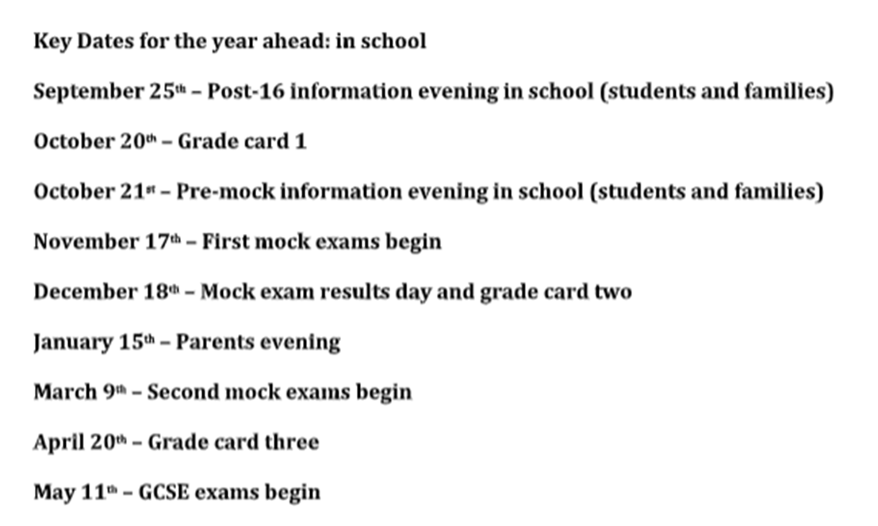

Slide 3


Slide 4
Purpose of this presentation:
Learn about the various options post-16
Understand entry requirements
Provide overview of application process
Share key dates in school calendar/college open events

Slide 5
Leaving Elton – what happens next?
all young people must stay in some form of education or training until their 18th birthday.
Young people can choose from…
Full-time education - at a school sixth form, sixth form or further education college or training provider
An apprenticeship or traineeship
Part-time education or training combined with one of the following:
Employment or self-employment for 20 hours or more a week
or volunteering for 20 hours or more a week

Slide 6
FE Colleges – lots of choice!
Bury College Holy Cross College
Bolton College Bolton Sixth Form College
Hopwood Hall College The Manchester College
Radcliffe FC Academy Myerscough College Salford City College Oldham College
UTC Creative College

Slide 7
Student destinations 2024 25 (211 students)

Slide 8


Slide 9
A Level Study Programmes
Study over 2 years, most will take 3 but there are options to blend with vocational qualifications
Assessment based on exams
Progression to higher apprenticeships, higher education or direct into employment
https://www.informedchoices.ac.uk/

Slide 10
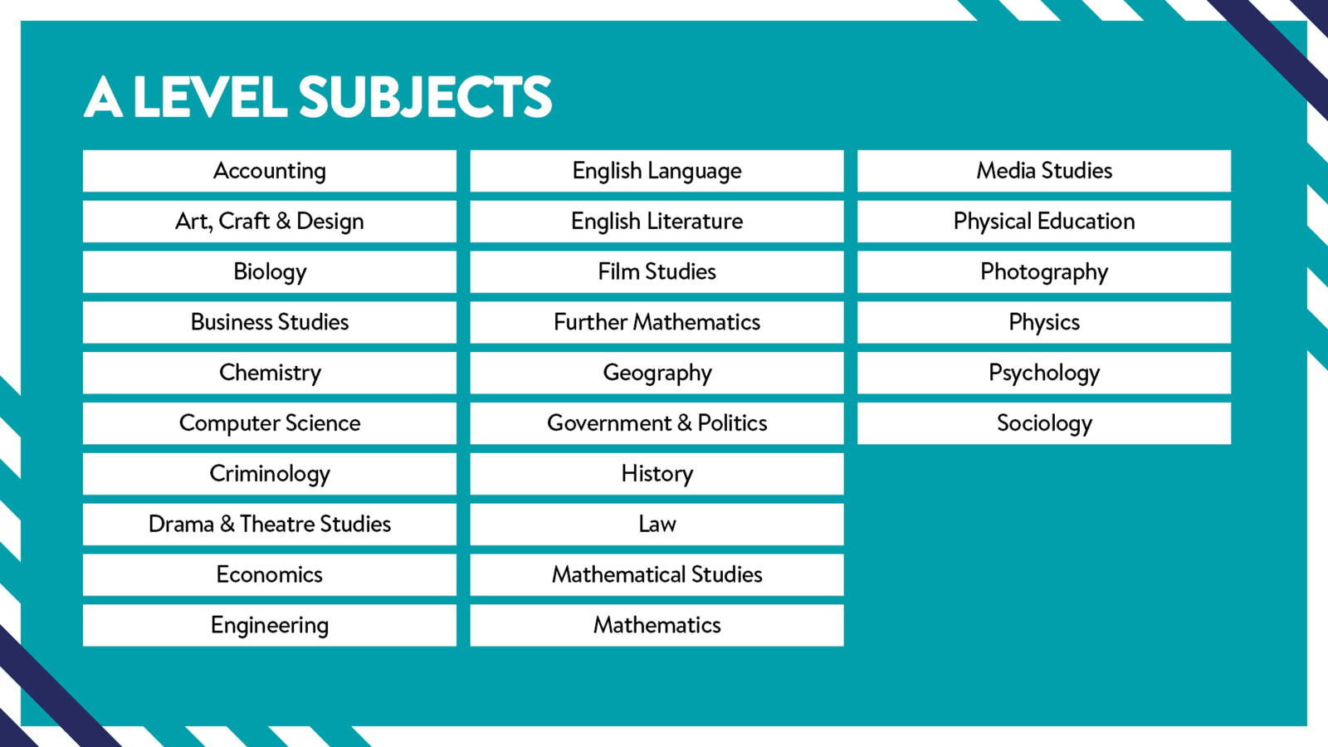

Slide 11


Slide 12
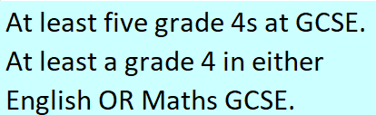
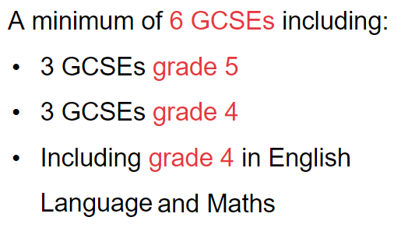
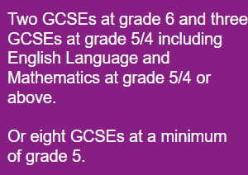
A Levels – General Entry requirements:
NB – Individual subject entry requirements must be met in addition to…
Holy Cross College
Bury College
Bolton Sixth Form

Slide 13

T Levels
‘Technical’ Levels
Aimed at 16-18s
Equivalent to 3 A levels
Designed with employers so qualification meets industry needs
https://www.tlevels.gov.uk/

Slide 14


Slide 15


Slide 16


Slide 17


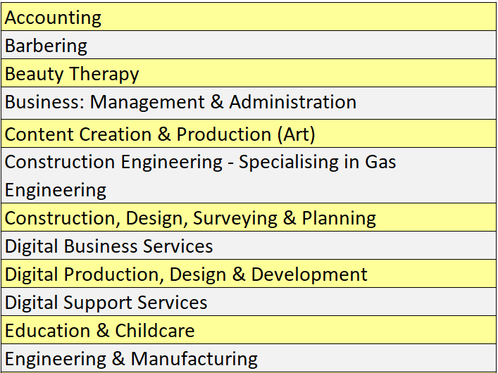
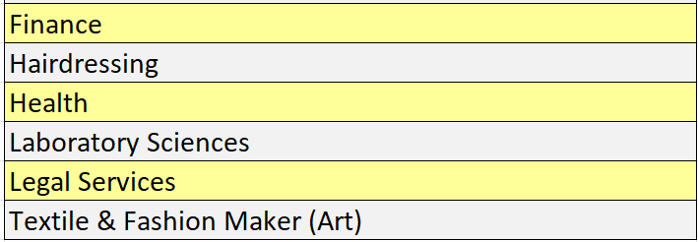
T Levels (Bolton College)

Slide 18
T Levels – How you will be assessed
Exams
Employer Set Projects
Controlled Assessments
Practical Skills Tests

Slide 19
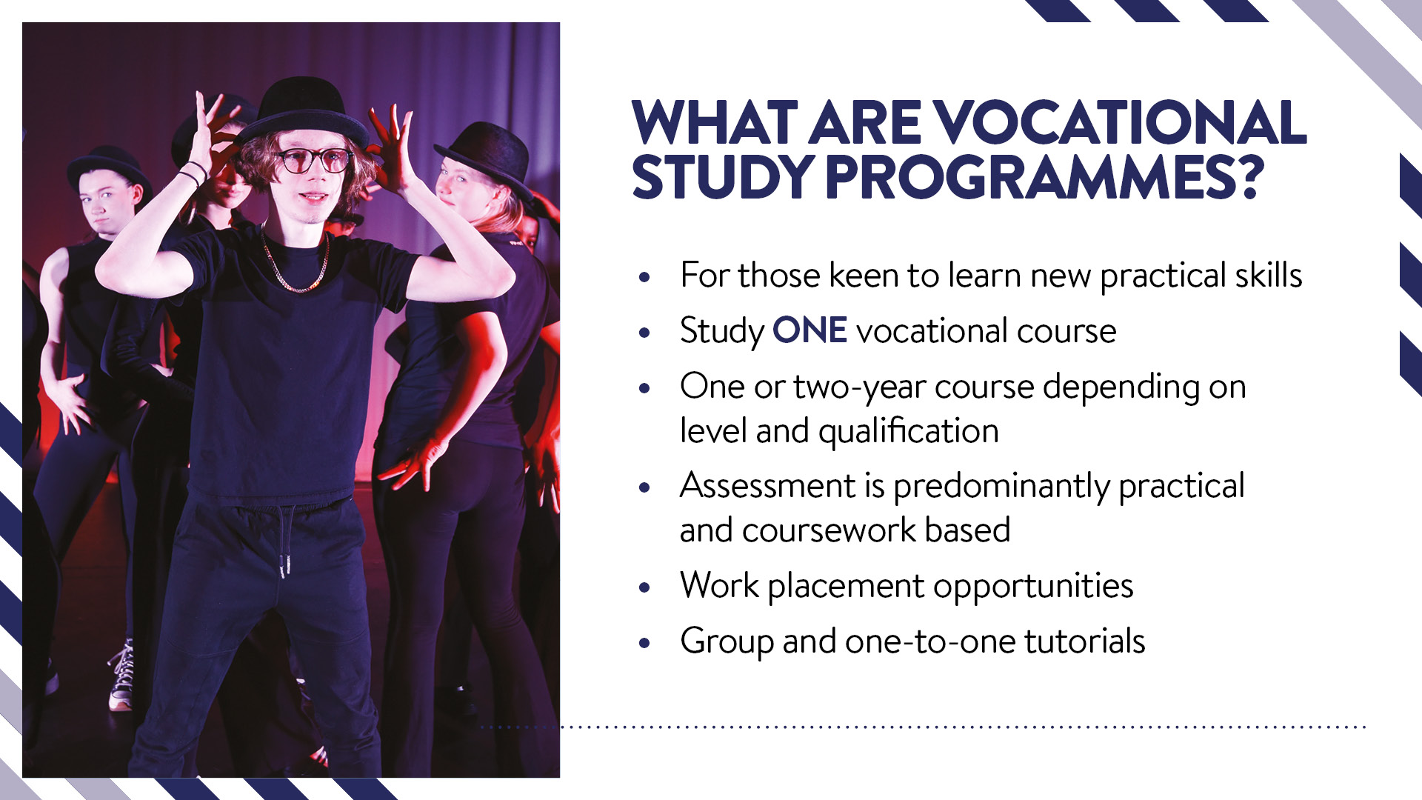

Slide 20
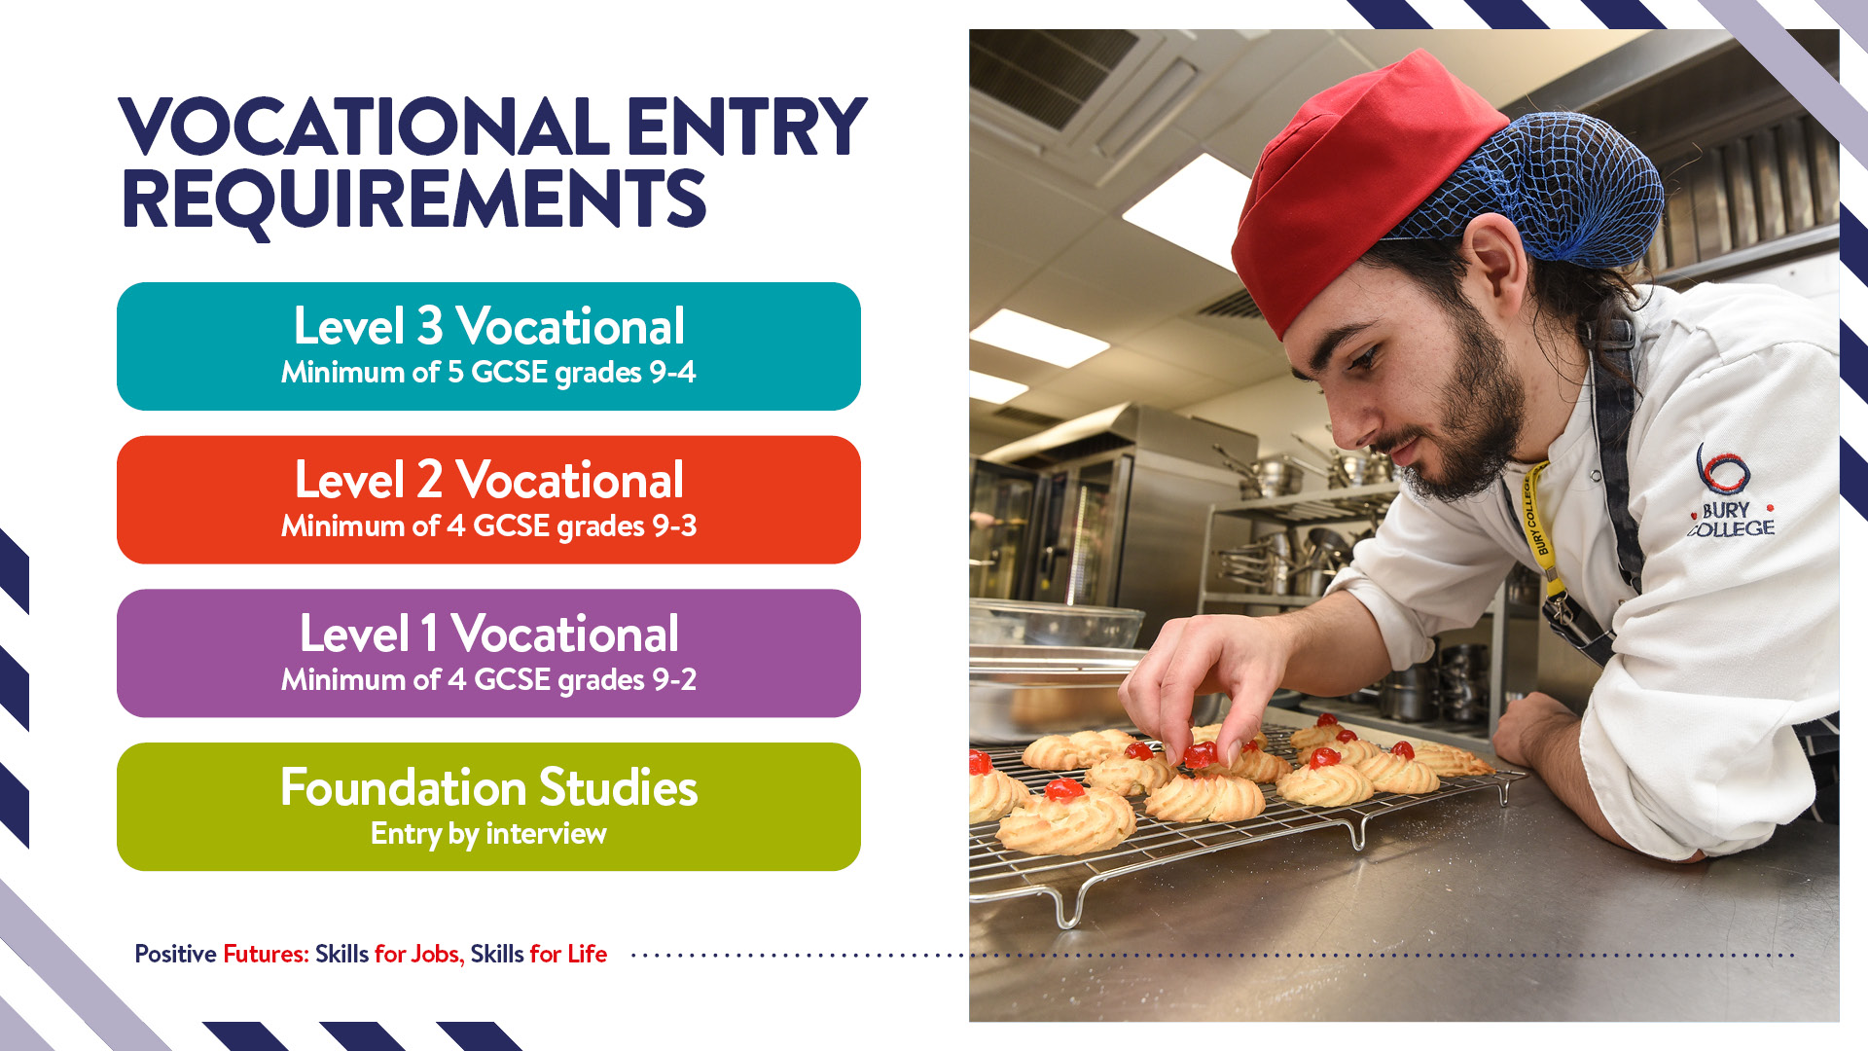

Slide 21
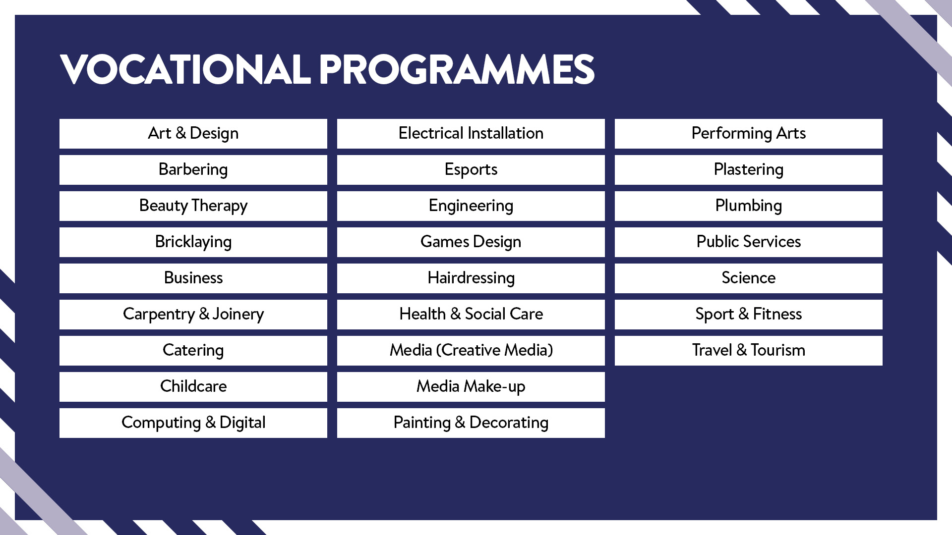

Slide 22
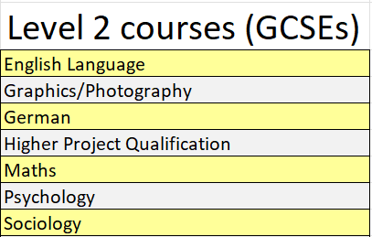
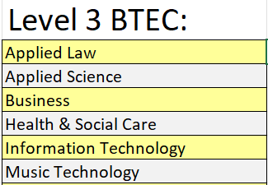
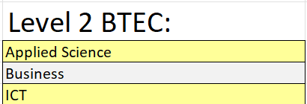

VTQs (Holy Cross)

Slide 23
Vocational Qualifications – Entry Requirements
Level
Entry Requirements
Equivalent to A-level –
good preparation for higher level
apprenticeships and University
Level 3
Minimum of 5 GCSEs at Grade 9-4
Level 2
Minimum of 4 GCSEs at Grade 9-3
Equivalent to GCSEs at Grades 4-9
Starter qualifications – equivalent to
GCSEs at Grade 1-3
Level 1
Minimum of 4 GCSEs at Grade 9-2
Foundation courses – entry by interview

Slide 24


Why Choose
an Apprenticeship?
On average, achieving a Level 3 Apprenticeship boosts earnings by 16%*
90%
of apprentices will get a job or progress to further training*
83%
of employers would recommend Apprenticeships*
*National Apprenticeship Service
Notes:
“Earn while learn”, “job-ready”

Slide 25
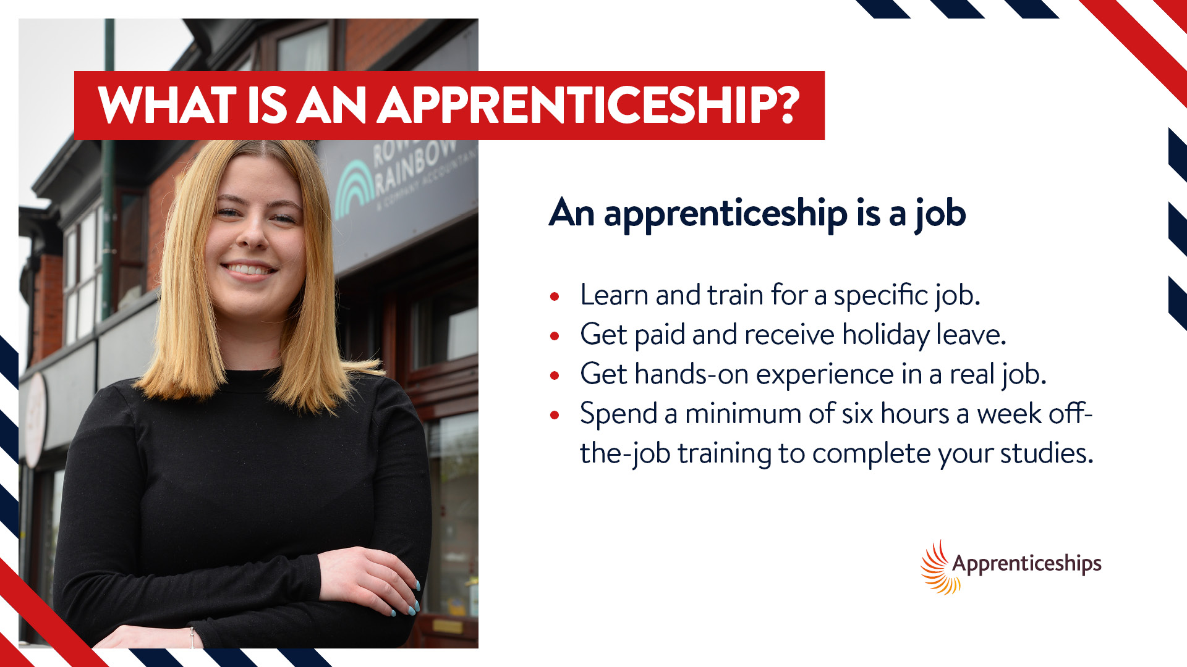

Slide 27
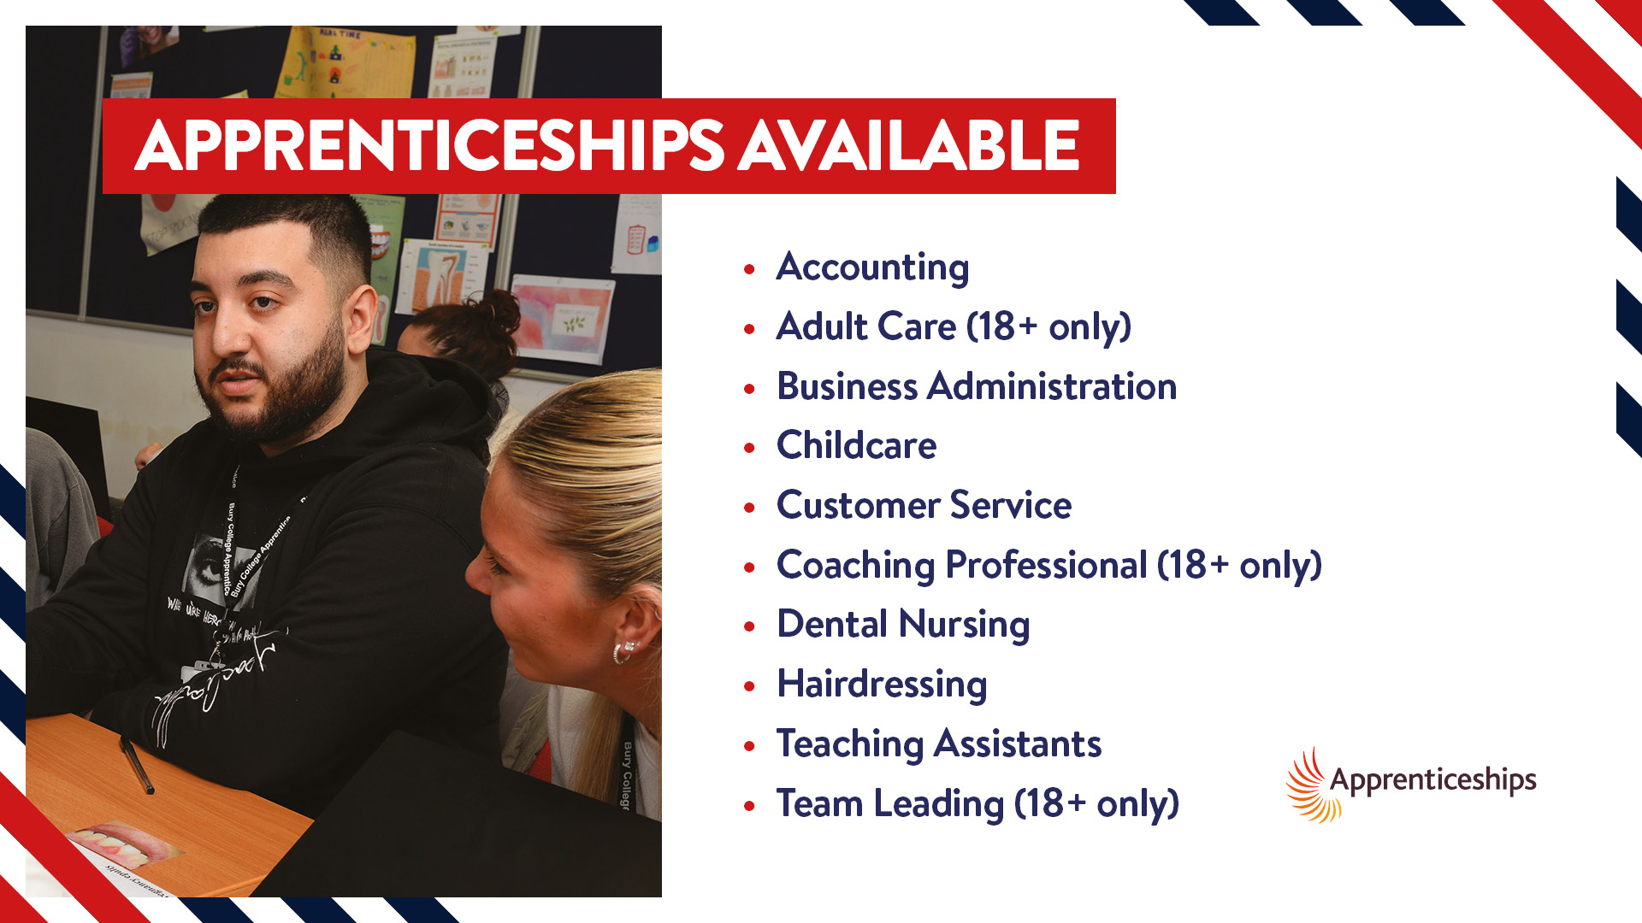

Slide 28
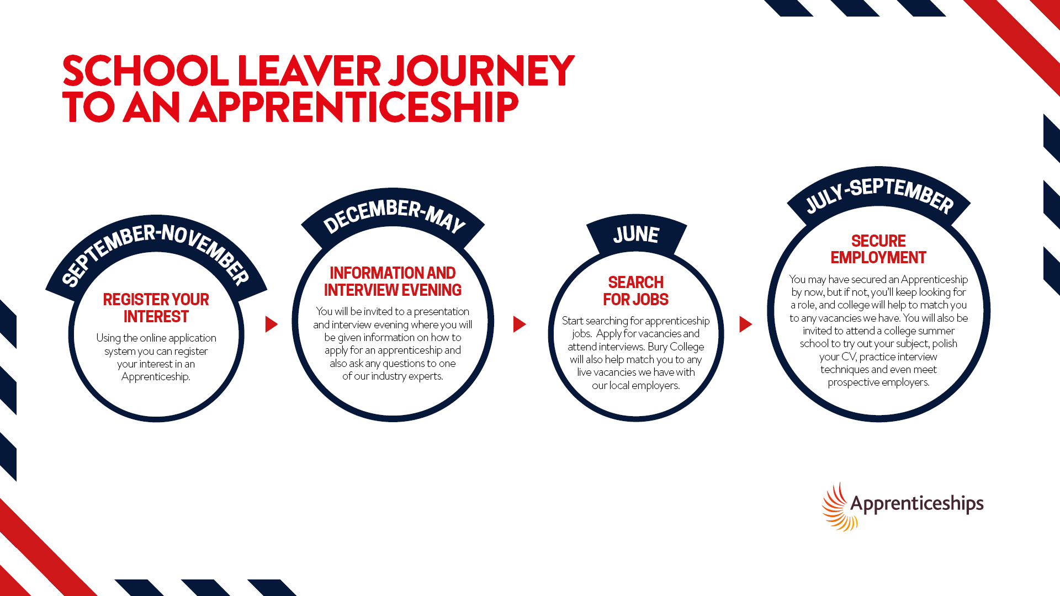

Slide 29
Apprenticeships – Entry Requirements
They vary. In the end, it's up to the employer offering the apprenticeship.
Better your qualifications, more likelihood of getting the place
Apprenticeship
Typical Entry Requirements
Typical Length
Intermediate
(level 2)
Over 16 – demonstrable interest
in the area of work
12 – 18 months
Advanced
(level 3)
five GCSE passes graded at 9 – 4
inc. English/Maths
18 – 24 months

Slide 30
Intermediate Apprenticeships (level 2) currently on offer locally (sample):
Customer Service Co-ordinator Apprentice with Energy Counsel
English and Maths (Grade 4+) Essential
Apprentice Pharmacy Assistant with Future Care Pharmacy
Maths/English (Grade Grade 4+) Essential
Science (Grade 4+) Desired
Parts and Service Advisor Apprenticeship - Perrys Vauxhall Bury
English and Maths (Grade 4+) Essential
Apprentice Administration Officer – Regency Factors Limited
English and Maths (Grade 4+) Essential
Customer Service Assistant Apprentice - GB Vehicle Leasing
English and Maths (Grade 4+) Essential
Early Years Apprentice – Fisherfield Farm Nursery Ltd
English and Maths (Grade 4+) Desired

Slide 31
Apprenticeships – how to apply
Find An Apprenticeship website
https://www.gov.uk/apply-apprenticeship

Slide 32

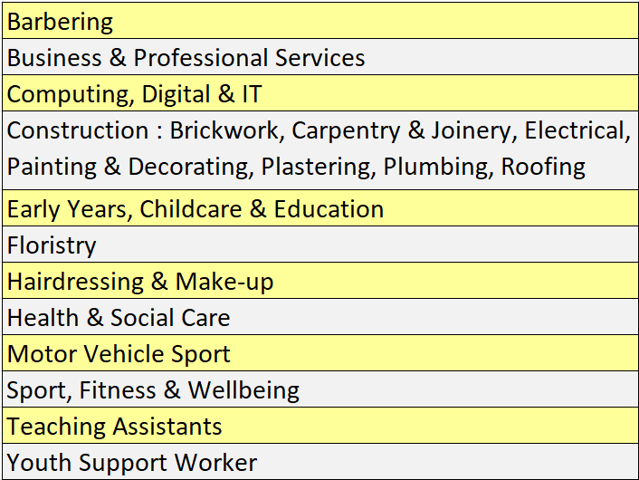
Apprenticeships – what’s available?
Bury College
Bolton College

Slide 33

Traineeships
Aimed at 16-18s
Work experience and work preparation at the heart of the programme
Route to apprenticeship or into employment
Most 6 months or less
70 hours spent in a work placement
Guarantee of an interview at the end of the placement

Slide 34

RESEARCH! –
GET INFORMATION ABOUT COLLEGES AND COURSES
GO TO THE OPEN EVENTS –
PICK UP PROSPECTUS, TALK TO THE PROVIDERS, ASK QUESTIONS
EXPLORE COLLEGE WEBSITES –
STUDENT TESTIMONIAL VIDEOS, VIRTUAL TOURS, LIVE CHAT,
SUBMIT QUESTIONS, ONLINE PROSPECTUS

Slide 35


Slide 36


Slide 37
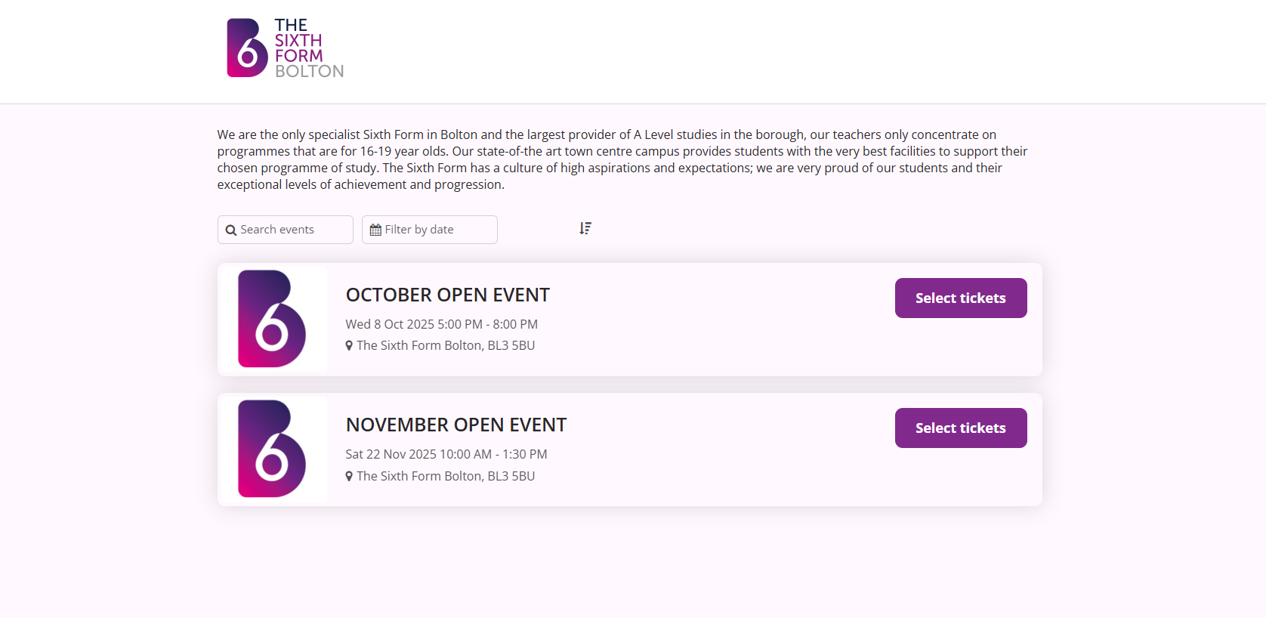


Slide 38


Bolton College

Slide 39




Slide 40



Slide 41
Application Process
INFORMATION
College website
Prospectus
Open Day/Taster events
APPLICATION
Mostly online – check deadlines; use school support
Multiple applications
Reference requests
INTERVIEWS AND OFFERS
Students informed of decision and offer made – often conditional upon grades.
GCSE RESULTS
Offer confirmed or discussion takes place.
Induction and enrolment.
POST 16 SUPPORT
School college liaison
Results enquiries
References

Slide 42

Dedicated In School Support
Student Support Team | Mr Meighan – Post 16 Lead Ms Warden – SLT Link Mr Aldred - Learning Coordinator Y11 Y11 Form Tutors Ms Leighton - SENDCo Mrs Cath Foulkes - School Careers Advisor Liam Whitehead – Connexions Service Advisor

Slide 43
Dedicated In School Support
What support do we have in place for college applications and careers guidance? | College taster days. Dedicated PD sessions focused on creating CVs and personal statements. Dedicated PD sessions on making college applications. College application support from Rosie Rafferty of Bury College. Mock Interviews (Fri 7th Nov). Individual careers meetings with Cath Foulkes. Referral to Connexions service for those that may need extra support. We provide individual references for all college applications.

Slide 44
Further questions –
meighank@eltonhigh.bury.sch.uk

